Slide 1
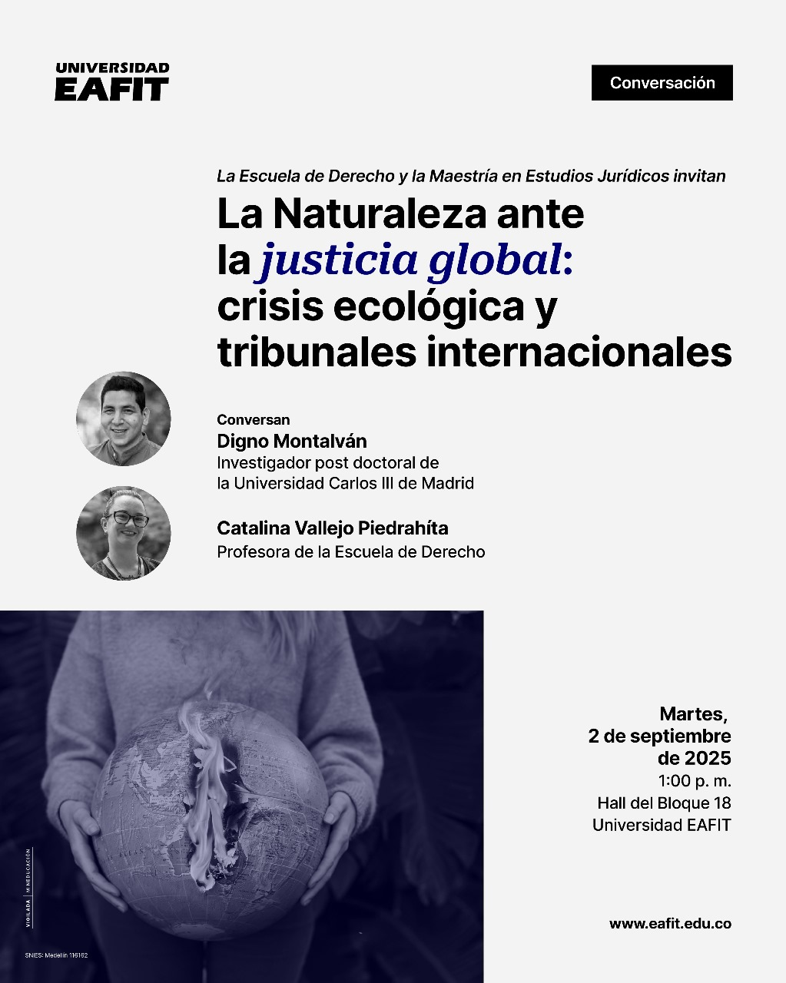

Slide 2
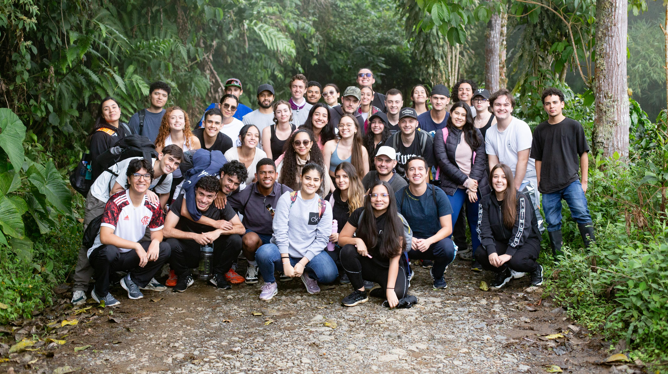


ABORDAJE INSTITUCIONAL PARA LA EDS Diplomado ACT4SDGs: Transformación curricular para la sostenibilidad
Alejandro Álvarez-Vanegas
Universidad EAFIT
2025

Slide 3

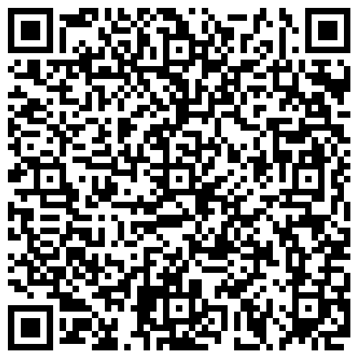
Reimagining Higher Education for an Ecological Civilization | SpringerLink

Slide 4
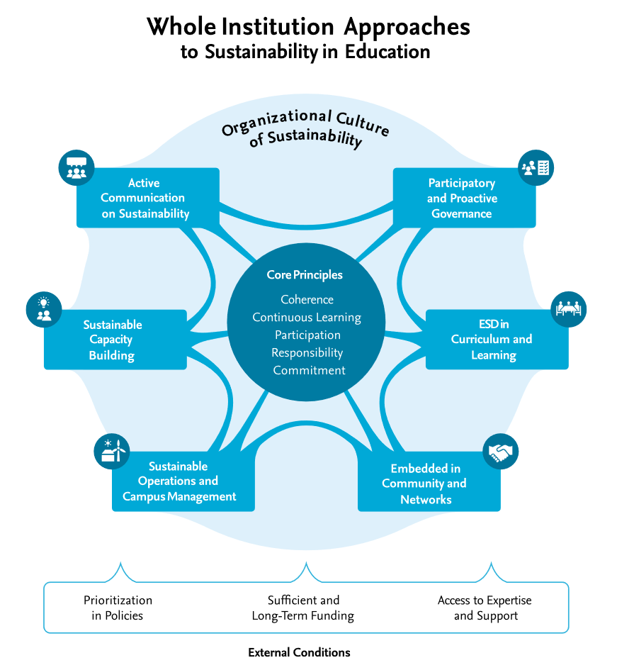
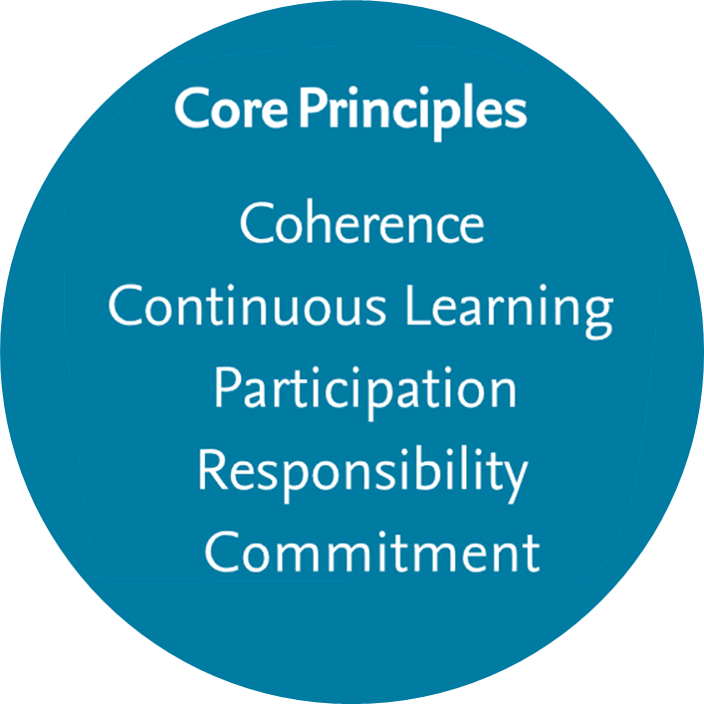
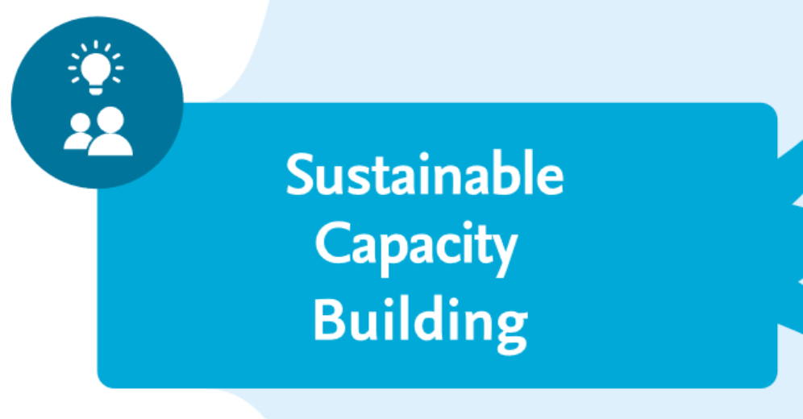
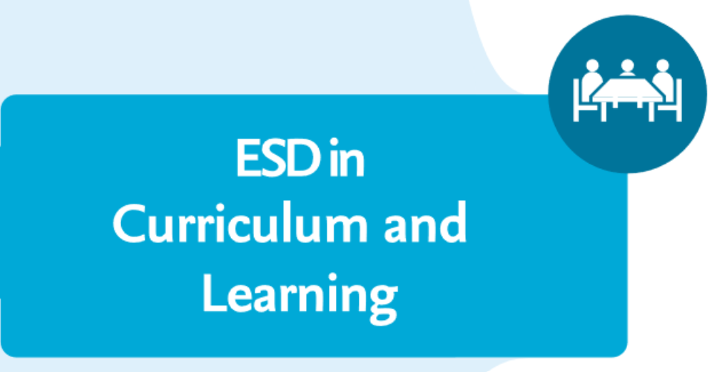

(Holst et al., 2024)

Slide 6
“Active capacity building for educators and nonteaching staff by fostering sustainability and ESD competencies, building support structures and prioritizing sustainability within human resource management”.

Slide 7
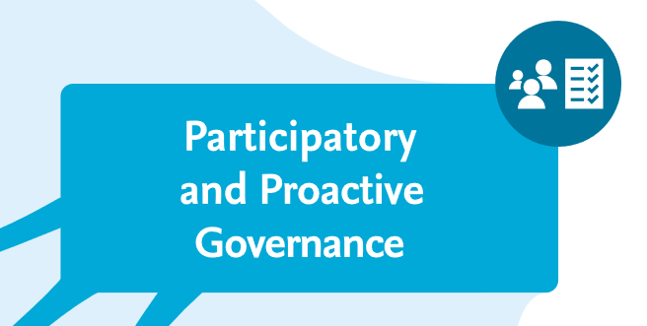
“Cross-disciplinary integration of ESD as an actionoriented, situated, holistic and emancipatory approach to curriculum and learning, in which social–emotional and cognitive learning are equally considered”.

Slide 8

“Participative and proactive governance and leadership, which empowers and supports a process of continuous institutional development in line with the principles of sustainable development (SD), involving the relevant stakeholders from all parts of the organizational community”.

Slide 9
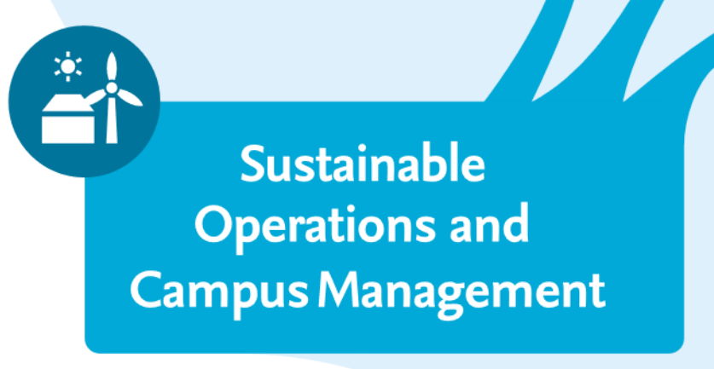
“Close and reciprocally engaged embeddedness in local communities and inter-organizational networks as collaborative real-world learning grounds”.

Slide 10

“Sustainability-oriented operations and campus management (e.g., buildings, campus, materials, food and drink, mobility), which provide real-world opportunities for collaborative sustainability learning”.

Slide 11

“Clear, consistent and active communication on (un-) sustainability both within the organization and toward the outside”.

Slide 12
“Importantly, the areas of action are viewed as intertwined and interdependent. Connecting all areas of action, the organizational culture describes the shared beliefs, values and meanings that underlie the system of rules-in-use within any given organization and is therefore viewed as of critical importance for WIAs.”.

